Slide 1
git III merge conflict II
To finish the merge after manually fixing the conflict
>git add conflicted_file.txt
> git commit -m “merged”
To resolve conflict where file was modified in one branch and deleted in another branch.
Decide keep or delete
if keep
>git add file_to_keep.txt
if remove
>git rm file_to_remove.txt
To launch meld as the mergetool
I set up as directed here
The instructions are to run
>git mergetool

Slide 2
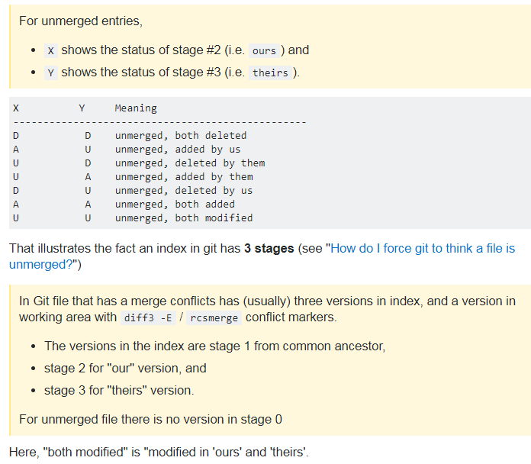
git III merge conflict III Explanation of ‘status XY after merge’
After merge conflict manual resolution the merged file may still show something like
>UU for status.
It is trying to tell you about the two parents and why there is a conflict.
For example one parent tried to delete the file and the other parent changed it.
This is the
Stack overflow answer
for what does
‘both modified’
mean?
one comment was:
It's modified "since" or
compared to both parents.

Slide 3
git V
Merge No FF
Why?
So that a merge commit is created to have a record of where the branch was brought back
>git merge --no-ff <branch>
It opened a editor to create a message, so it probably takes a -m “<message>” option

Slide 4
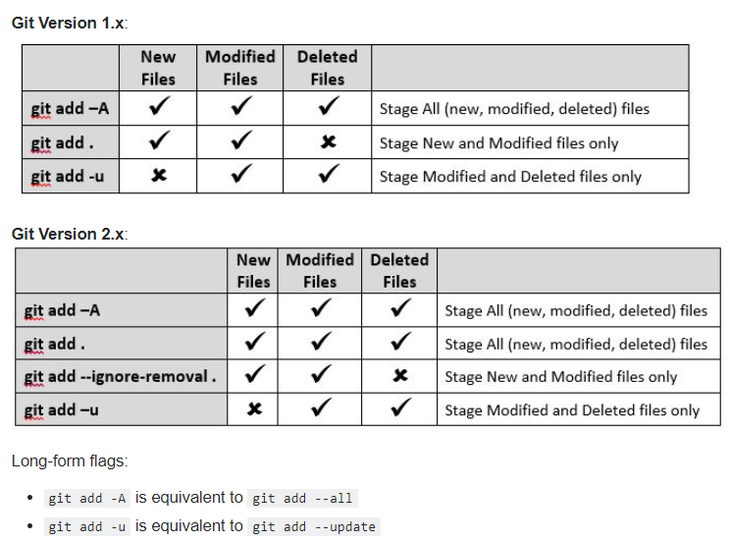
git VI.1 how to stage 1)current folder, 2) All modified and deleted without staging untracked
-u is
update index
On the
current path
only!
Very useful!

Slide 5
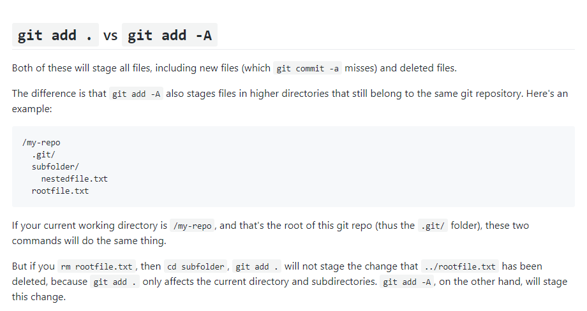
git VI.2 git add –A vs git add .

Slide 6
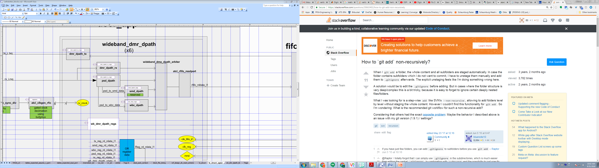
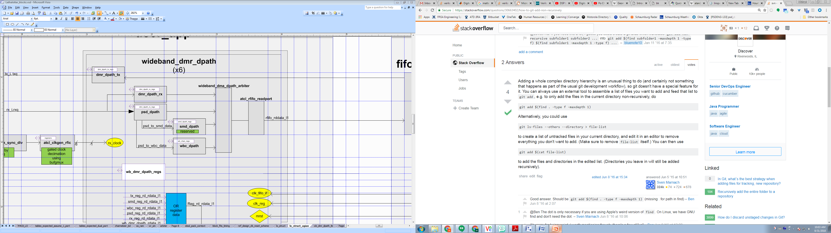
git VI.3 how to stage Current folder only, don’t recurse into subfolders
For TCSH (use backquotes above tab key,
not the single quote, also not $(cmd) )
>git add `find . –type f –maxdepth 1’

Slide 7
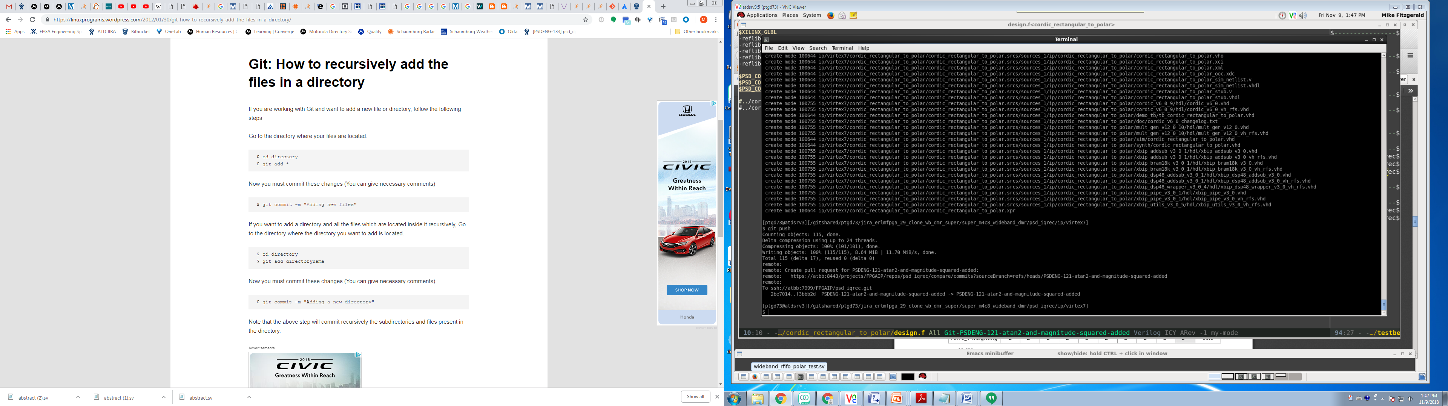
git VI.4 how to recursively add the files in a directory

Slide 8
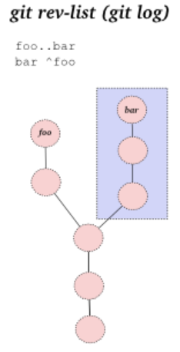
git VII Git Stuff
Bare double dash --
Contrast the control portion of the command line from a list of operands.
Use to separate and explicitly identify filenames if the might otherwise be mistaken for
another part of the command.
Example: You have a file and a tag named main.c, then there will be a difference between
#checkout the tag
>git checkout main.c
#checkout the file
>git checkout -- main.c
double dot
For branches A and B
git log A..B
will show you all of the commits that B has that A doesn't have.
Checkout the previous branch
>git checkout s

Slide 9
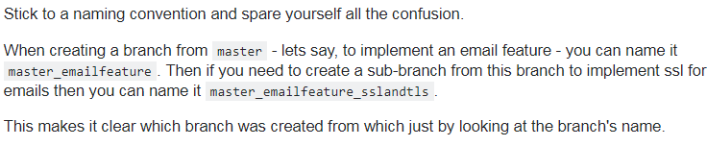
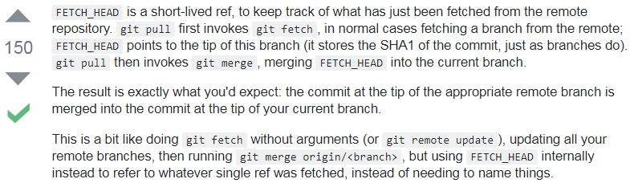
git VII.5 More Git Stuff
How do I know where the branch I am on came from?
What is FETCH_HEAD?

Slide 10
git VII.75 Still More Git Stuff
How do I name branches
br_<branch name>
or
<function>/br_<branch name>
<function> can be
feature
bugfix
hot fix
release
custom
Remember
pulling or fetching only does the current repo/submodule
Delete remote branch
SO Link
Created a bad branch name, wanted to remove it (has .sv at the end)
This was allowed, a bit surprised, however there were no commits (local or pushed) to this branch.
Had already done a fetch, so it existed locally
Start from a point where another branch was checked out (can’t delete it if it’s the current branch)
>git branch –d feature/br-ERLMFPGA-53-wideband_dmr_dpath_regs.sv
>git push origin --delete feature/br-ERLMFPGA-53-wideband_dmr_dpath_regs.sv

Slide 11
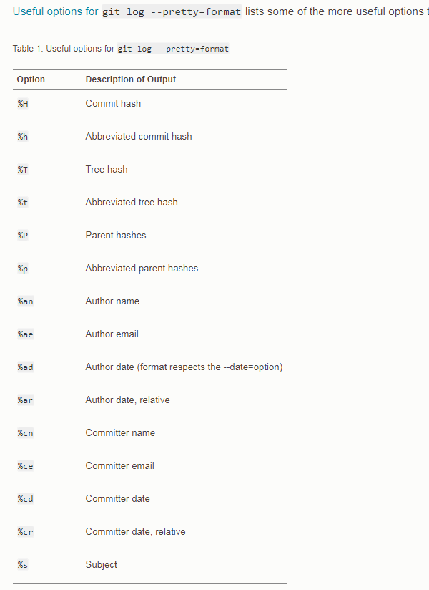
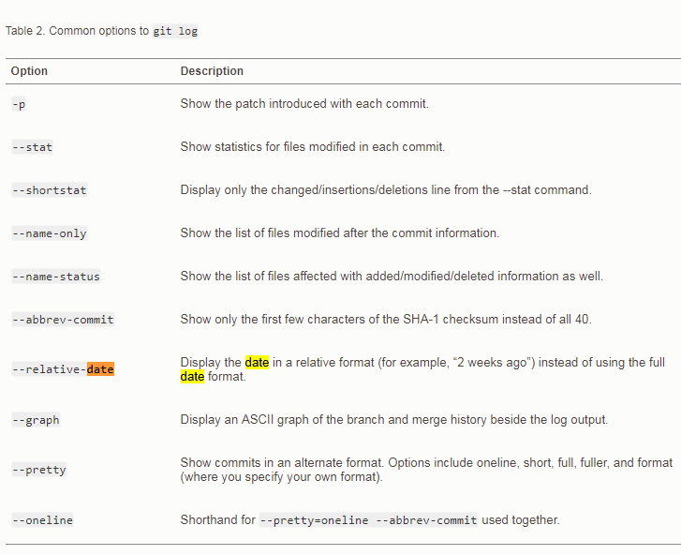
git VIII Git log options
Shows the diff ‘what changed’

Slide 12
git IX Git Diff
list files only
>git diff –name-only
no args
shows what will go into the index
branch against it’s upstream
Need the branch names
Find the branch names using git branch –a
git diff <branch> <branches_upstream>
Current branch against other branch:
$ git diff --name-status master
Any two branches:
$ git diff --name-status firstbranch..yourBranchName
Changes among files:
Files on two named branches
git diff branch1 branch2 -- myfile1.js myfile2.js
Branch1 is optional, current branch considered default:
git diff master -- controller/index.js
or
git difftool master -- controller/index.js

Slide 13
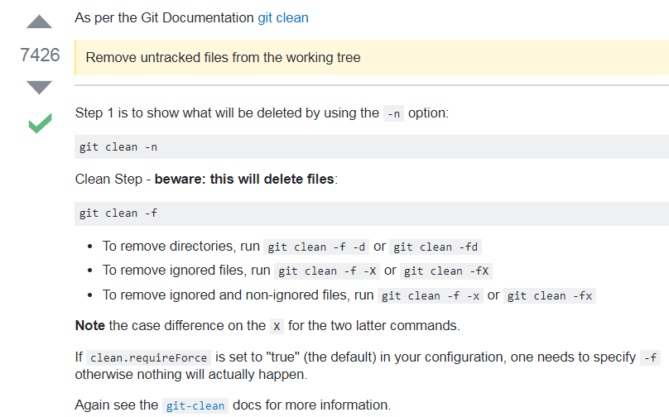
git X Git clean (how to remove untracked)

Slide 14
git XI
Pull request
A pull request is a server side merge.
To make a pull req, first merge the main branch to the feature branch and resolve
conflicts locally.
Some of the main branches are locked down, so there is no push.
You can only write/push them by a pull request.

Slide 15
git XII Stash
Note that stash is not required to move between branches. If a file is added to the index but not committed you can just switch branches & commit.
git stash action: - Stashes changes to tracked files (modified or added to index).
But it will not stash:
- New files in your working copy that have never yet been staged (untracked)
- Files that have been ignored
Adding the -u option (or --include-untracked) tells git stash to also stash your untracked files
>git stash push –m “my message”
Pushes the change to the stash list with a message.
>git stash pop
Popping your stash removes the changes from your stash and reapplies
them to your working copy.
>git stash apply
Reapplies the changes to your working copy and keep them in your stash.

Slide 16
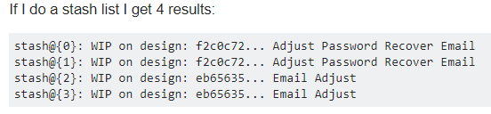
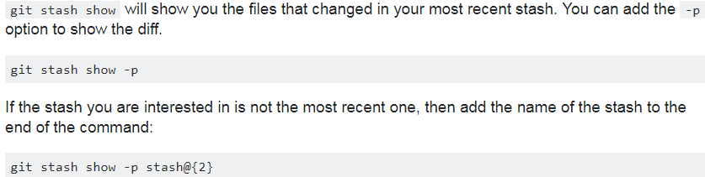
git XI Stash II
Applying a stash from the list of stashes
The keys into the stash are the stash@{n} items on the left.
>git stash apply stash@{0}
etc.
( in tcsh quote like this: "stash@{0}“ )
-p means show diff

Slide 17
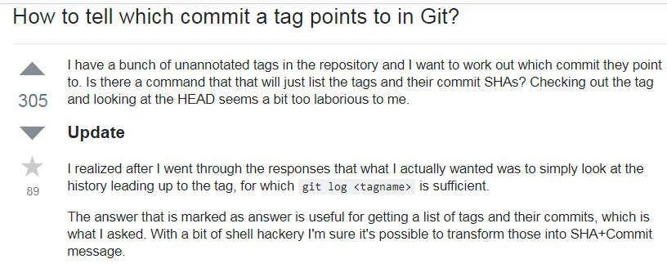
git XIII tag

Slide 18
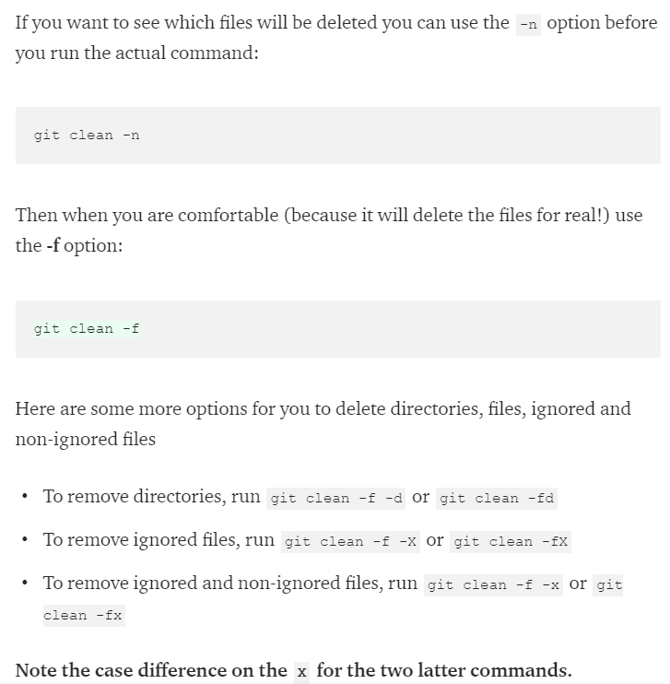
Git XIV Remove untracked files

Slide 19
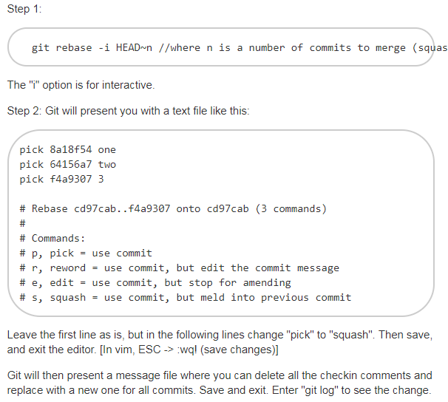
GIT XIV Rebase Squash 3 commits into 1, (removing two commit messages)
>git rebase –i HEAD~3
Leave the first, change the 2nd two to squash

Slide 20
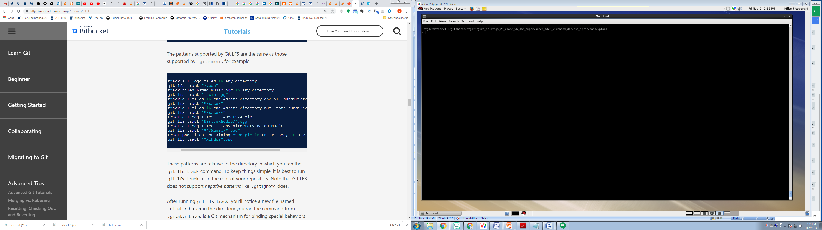
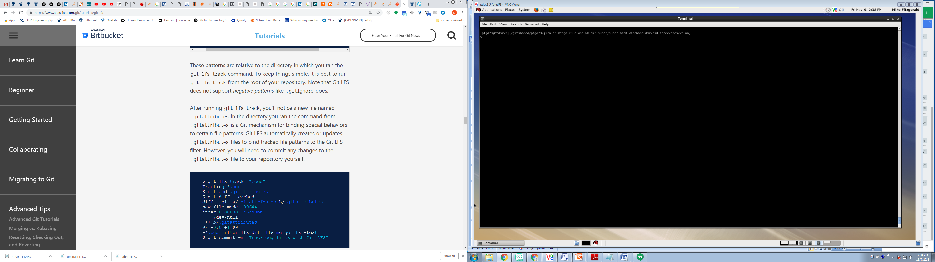
GIT XV LFS Add
Add folder and it’s contents recursively
yes,
Is the psd_iqrec folder there is already a
.gitattributes file, so run git lfs add from there to have this file be the one and only
.gitattributes file for the repo
Don’t forget to add changes to the gitattributes file to git, and push

Slide 21
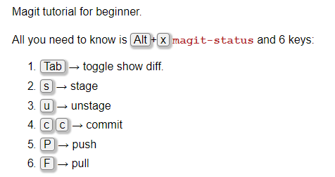
Xah Lee Magit
Magit

Slide 22
SV Event Scheduler
From previous
time slot
Region Sets
Regions
Details
Preponed
Preponed
read assertion
values
Active
Read rhs and assign lhs blocking assignments
Active
Inactive
#0 delay
don’t use
Read rhs NON blocking assignments
Events in active region
execute in any order
Active
NBA
make continuous assignments
$display command
Time
Observed
Observed
assert
assertions
NBA
assign LHS NON BLOCKING assignments
Active
Reactive
Inactive
All three are for
program block
don’t use
NBA
To next
time slot
Post
Post
Post
$monitor and $strobe

Slide 23
SV Event Scheduler Simplified
From previous
time slot
Region Sets
Regions
Details
Preponed
Preponed
read assertion
values
Read rhs and make lhs BLOCKING assignments
Read rhs NON blocking assignments
Events in active region
execute in any order
Active
Active
Active
make continuous assignments
$display command
$display can happen more than 1x/time, because of the loop.
Time
NBA
NBA
make LHS NON BLOCKING assignments
assert
assertions
$monitor asserts on signal change, only 1x per simulation.
To next
time slot
Post
Post
Post
$monitor and $strobe

Slide 24
Tmux, wimmi
>tmux -2 gives 256 colors rather than 8
Check out wimmi tiling window manager

Slide 25
Chrome
New tab
C-t
Open last closed tab
C-T
Close tab
- C-F4
C-w
Open Downloads folder
C-j
Move cursor to search bar
C-l/F6
Print
C-p
Bookmarks
C-O
Hide Show Bookmaks
C-B
Bookmark page
- C-d

Slide 26
SystemVerilog Websites
verificationguide.com
chipverify.com
vlsi.pro
svref.renerta.com
testbench.in
asic-world.com
markhardy.info
tenthousandfailures.com
www.fullchipdesign.com

Slide 27
SystemVerilog Testbench Dance Variations
verification guide style
pre_test
- resetDut
- configureDut
test
- fork
gen_main
drv_main
mon_main
scb_main
post_test
Chris Spear Book style
build
- generate configuration
- build enviornment
- reset Dut
- configure Dut
run
- start enviornment
- run tests
- wait for done
wrap up
- sweep
- report
testbench.in style
Run
- build
- reset
- cfg_dut
- start
- wait_for_end
- report

Slide 28
Websites
Best simple bottom line Python Web site
python_tutorials

Slide 29
Local Places (maybe a better name than this)
Matlab learning/experiments
~/stuff/matlab_examples

Slide 30
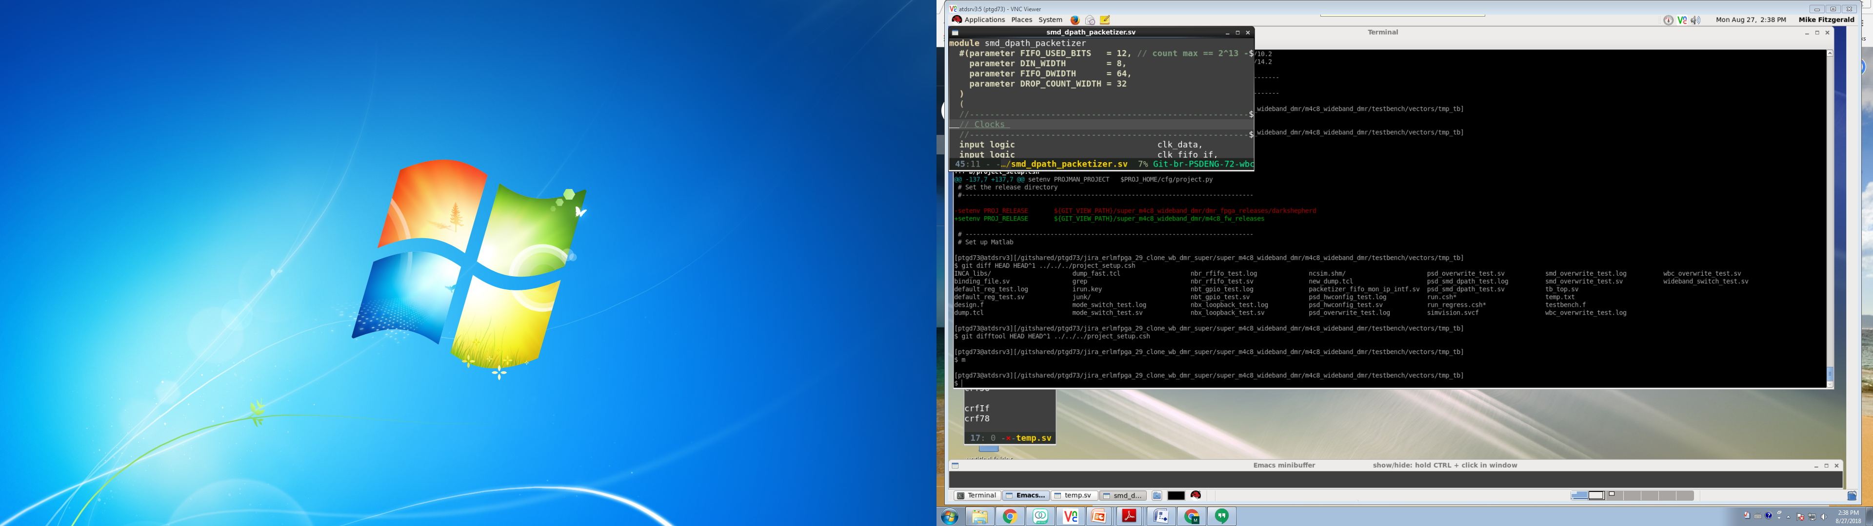
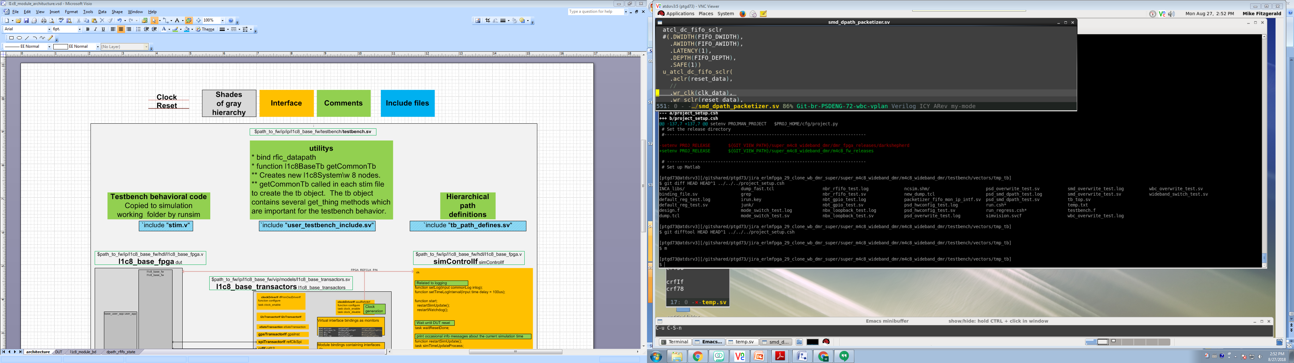
Verilog coding helpers I
peanut
logic <packed dimension> <signal name> <unpacked dimension>
motion
(
mode type name,
mode type name
);
my top secret peanut
mode type signed <packed dimension> <name> <unpacked dimension>
m-piano
olympiad
- module
- parameters
- instance
- association
- dun
- parameters
- instance
- association
man pads program
MODULE <name>
PARAMETER
ports
MODULE dun
PARAMETER
ports

Slide 31
Verilog need to know I
Null statement
This is an warning
If(a==2)
else
a_eq_2 = 1;
This is not a warning (put in a begin/end pair)
If(a==2)
begin
end
else
a_eq_2 = 1;

Slide 32
Generate label
Labels are helpful for
1) Seeing the new scope in waves named as you named it not a machine generated name.
2) A named space for a hierarchical reference to refer to
generate
begin :somename
<statements>
end

Slide 33
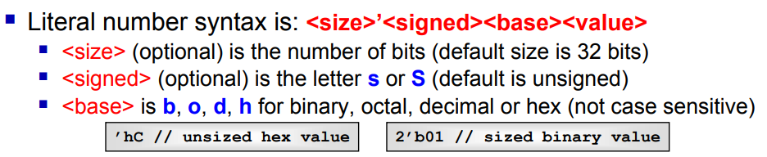
Verilog coding helpers I.5
single side band value
<size>’<signed><base><value>

Slide 34
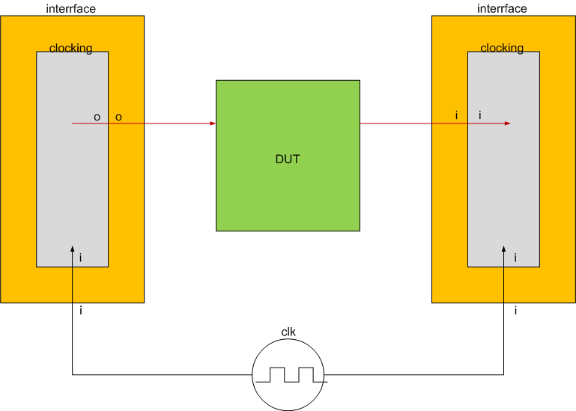
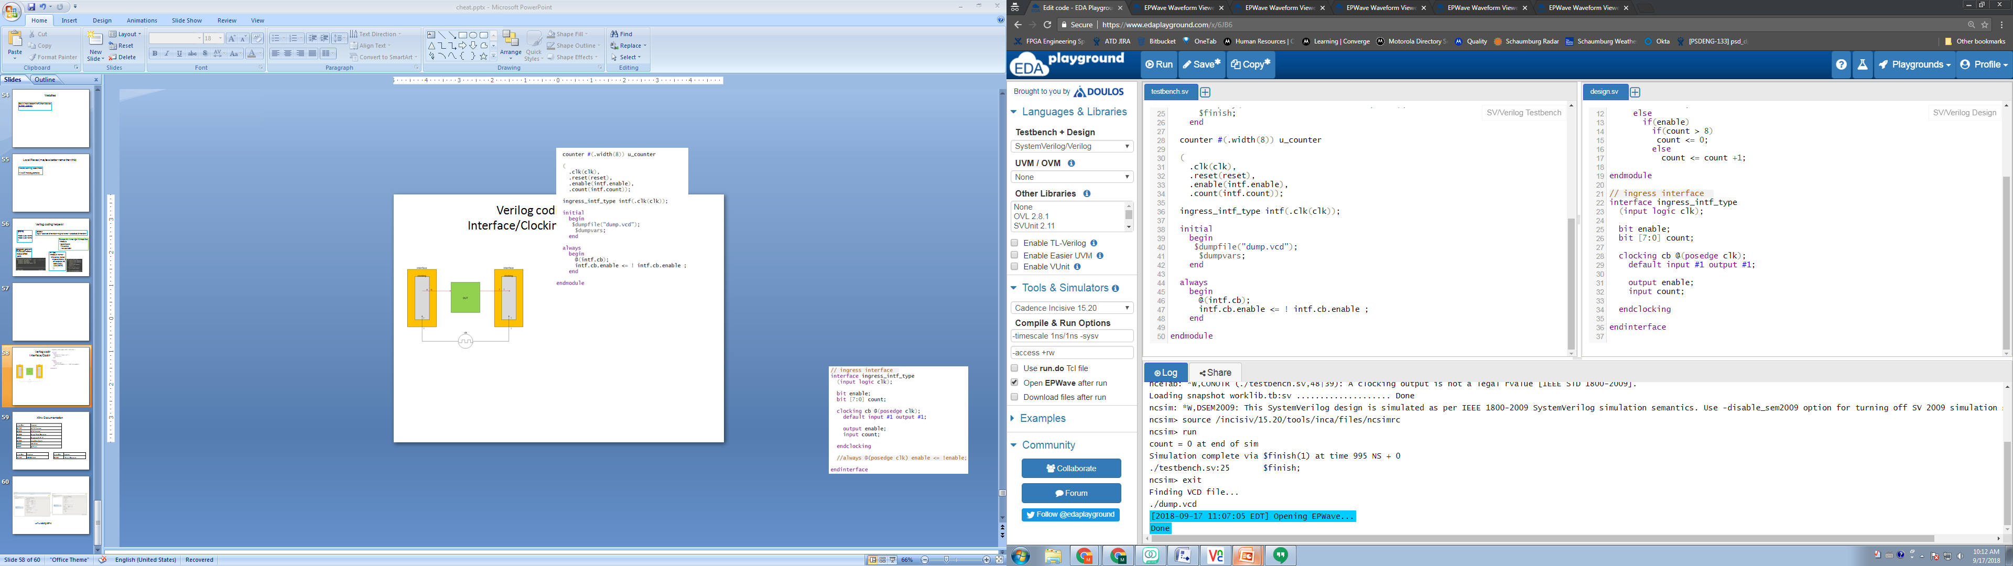
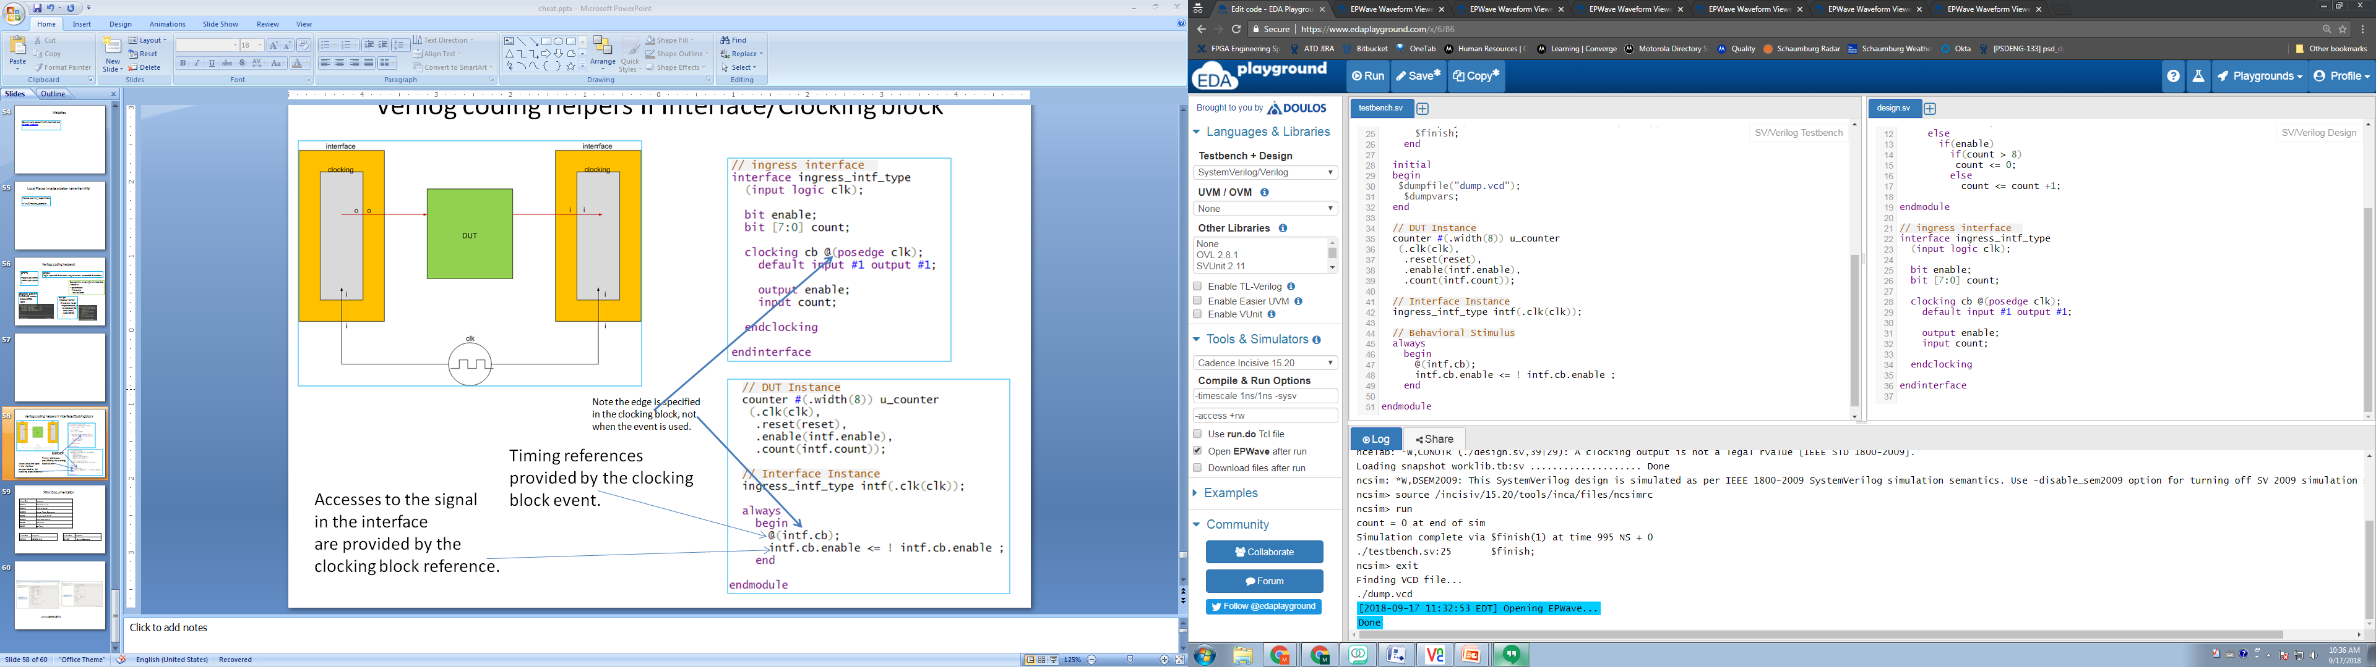
Verilog coding helpers II Interface/Clocking block
In this example the behavioral
stimulus is in the structural testbench.
It typically would be in a class using
a virtual interface to connect.
Note the edge is specified
in the clocking block, not
when the event is used.
Timing references
provided by the clocking
block event.
Accesses to the signal
in the interface
are provided by the
clocking block reference.

Slide 35
Xilinx Documentation
Xilinx Doc | Purpose
UG 472 | Clocking Resources (bufg, bufr, etc)
UG 761 | AXI Reference
UG 835 | Tcl Reference
UG 888 | Design Flows Overview
UG896 | Designing With IP
UG 903 | Using Constraints
UG900 | Simulation
UG901 | Synthesis
UG994 | Designing With IP Integrator
UG1118 | Creating and Packaging Custom IP
Xilinx Doc | Purpose
PG 105 | CORDIC 6.0
Xilinx Doc | Purpose
DS 180 | 7 Series Overview

Slide 36
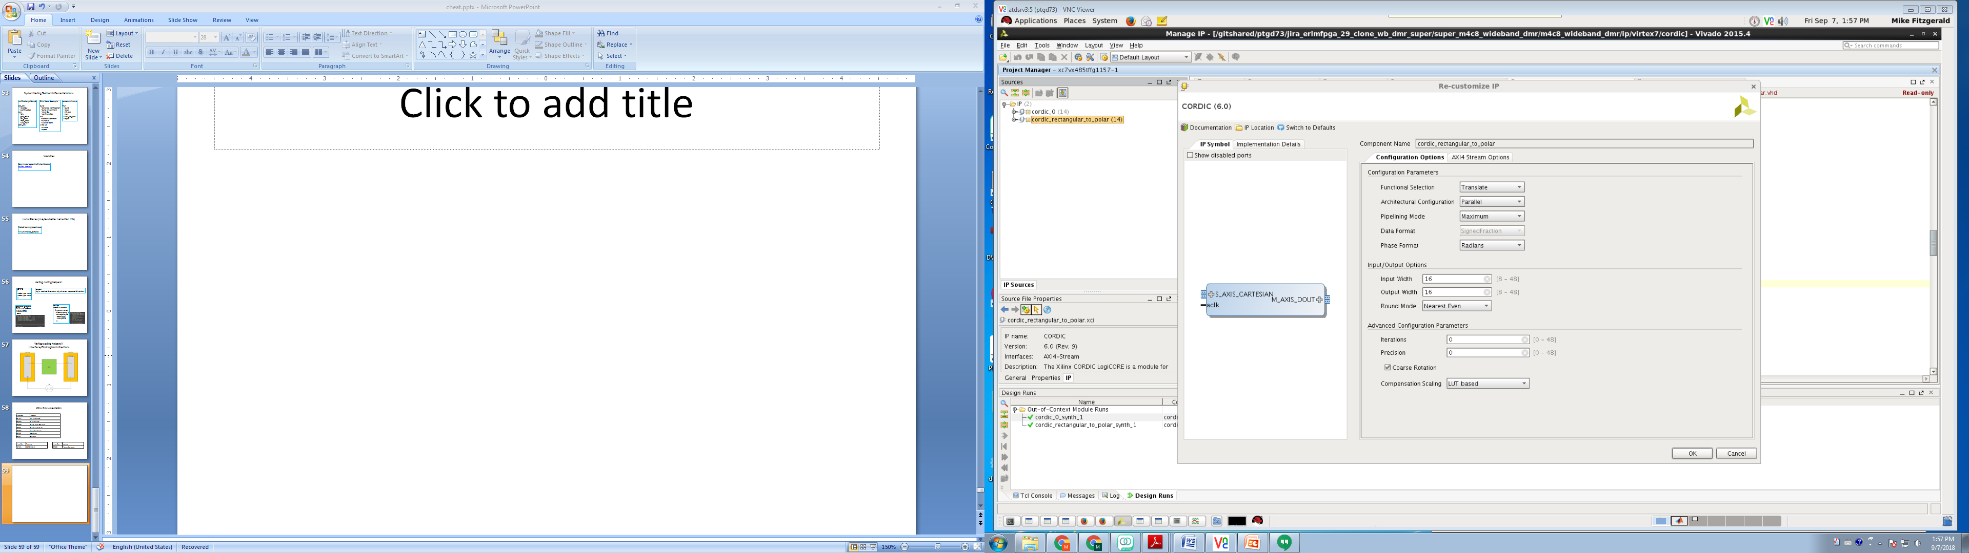
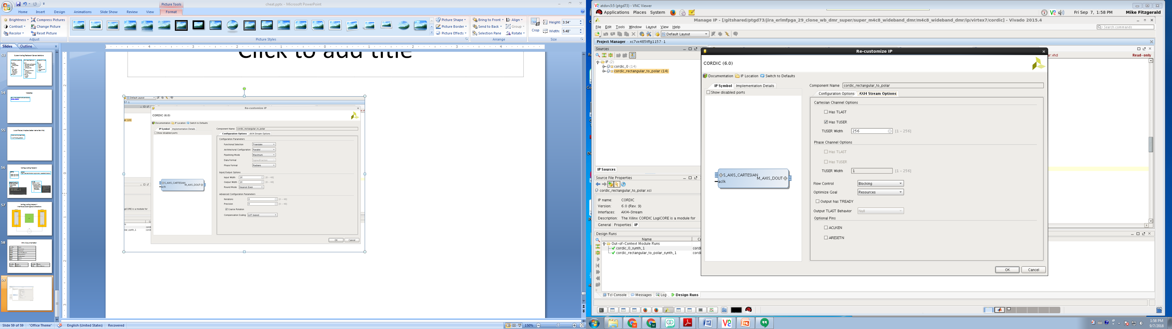
xc7vx485tffg1157-2

Slide 37
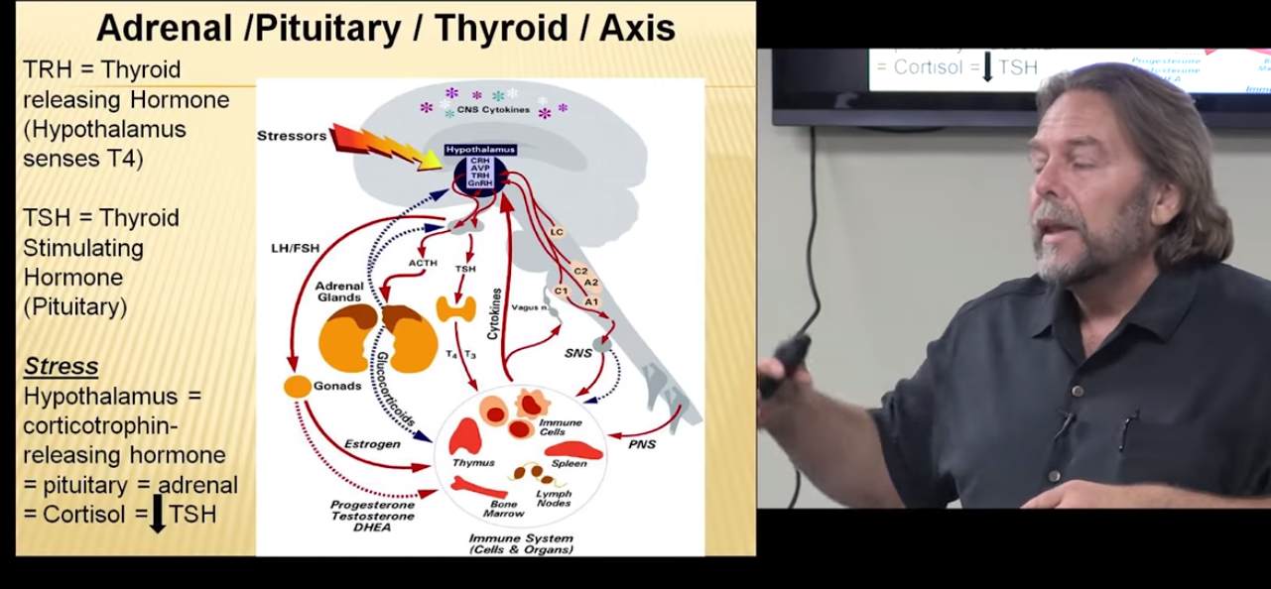
https://www.youtube.com/watch?v=p3V3TITSDxc Inflamatiory process causes adrenels to secrete cortizol and that slows down the thyroid.

Slide 38
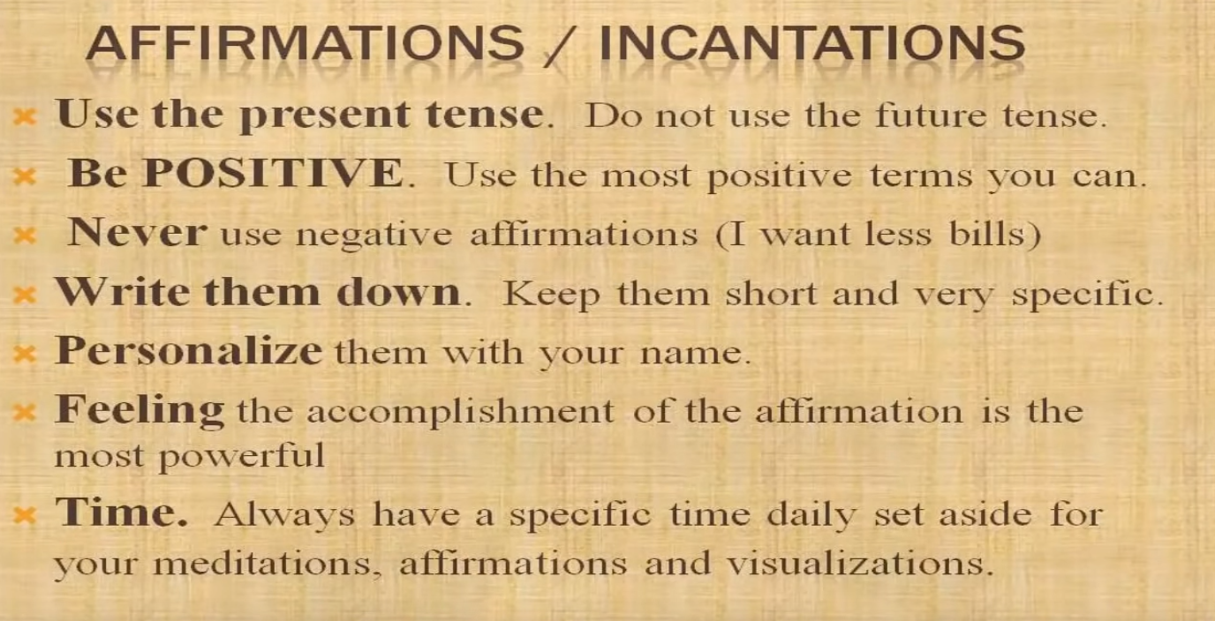
bergman

Slide 39
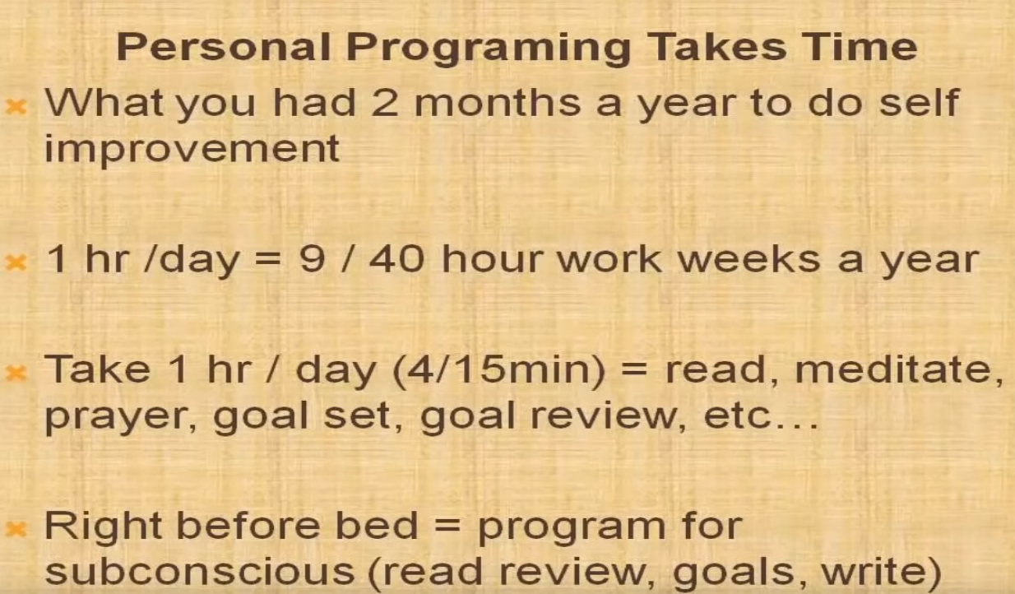
bergman

Slide 40
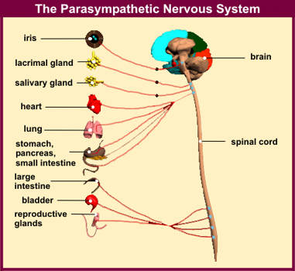
bergman Low functioning dangerous.

Slide 41
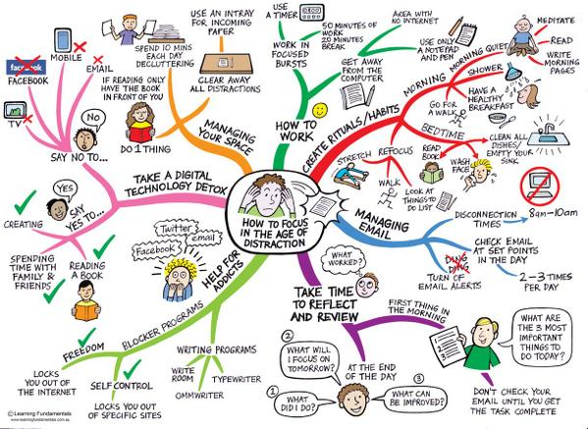
How to focus in the age of distraction

Slide 42
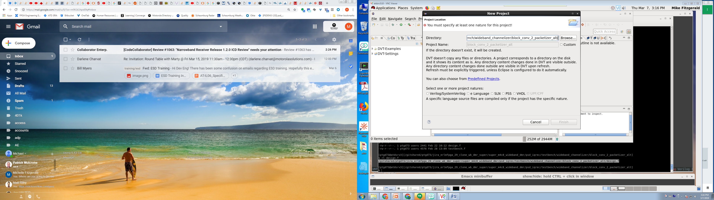
Eclipse DVT
>source /apps/fpgaenv/setup_tool.csh dvt 18.1.39
>dvt.sh
// Pat’s preferences.ini file, is shown in the gui.
+dvt_auto_link_root+super_fw_dev=${GIT_VIEW_PATH}/super_fw_dev +dvt_init+ius.irun -v93 -f runsim.f
Sorry I did not get that to you sooner

